Slide 1
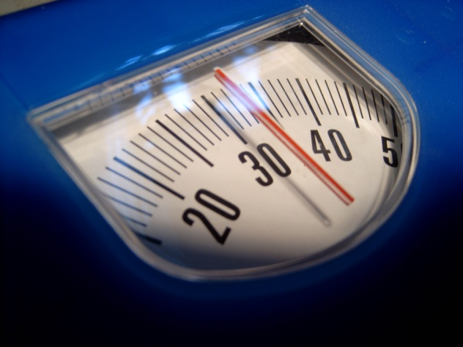
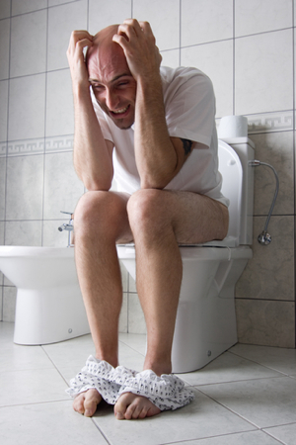
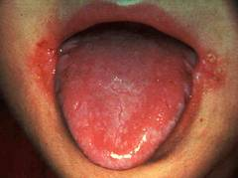
Malabsorption
Prof Madunil A Niriella
Professor in Gastroenterology

Slide 2
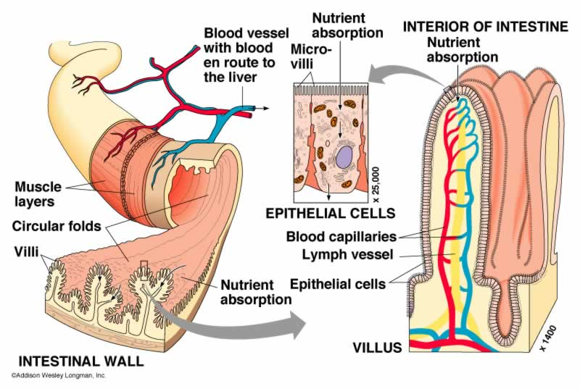
Intestinal absorption

Slide 3
Digestion & absorption
Luminal phase
Nutrients mixes with enzymes
hydrolysis and solubilization of nutrients
Mucosal phase
Absorption of digested nutrients via brush-border membrane of IE cells
Post-absoptive/Transport phase
Transport of absorbed nutrients via lymphatic and portal circulation

Slide 4
Malabsorption
Clinical term that encompasses
defects occurring during digestion and absorption of nutrients by the gastrointestinal tract
Single nutrient component
lactose intolerance due to lactase deficiency
Almost all nutrients impaired
diffuse disorders – Coeliac disease, Crohn disease

Slide 5
Malabsoprtion
Luminal defects
Intra-luminal maldigestion
over utilisation
Mucosal defect
Mucosal loss
Mucosal disease
Transport defects
Defective vessels or lymphatics

Slide 6
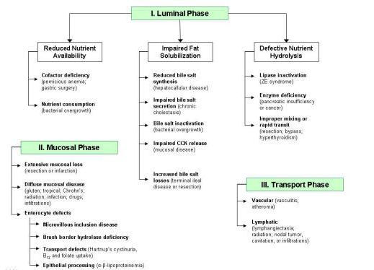

Slide 7
Clinical features
Weight loss or failure to gain weight
Flatulence and abdominal distension
Chronic diarrhoea
> 4 weeks; stool > 200g / D
Watery – osmotic load, hydroxy FAs
Steatorrhoea – pale, bulky, malodorous
Features of nutritional deficiencies
Hypoalbuminaemia - oedema
Fe, folic acid, B₁₂ – anaemia
B₁₂ – peripheral neuropathy
Vitamin K – easy bruising

Slide 8
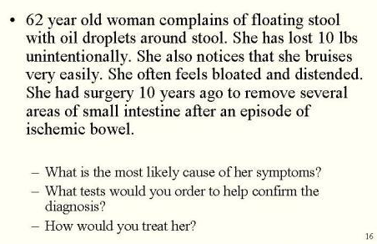
Case presentation 1

Slide 9
Fat malabsoption
Steatorrhoea – “Oily stools”
Possible deficiencies of fat soluble vitamins – A,D,E and K
Causes
Bacterial overgrowth
Pancreatic insufficiency
Mucosal disease

Slide 10
Fat malabsoption
Sudan III stain of stools
72 hour stool collection and estimation of faecal fat excretion
High fat diet (100g/D) for 3 days
>7 g /D positive test (>7% of daily fat intake)

Slide 11
Bile salt inactivation - SIBO
Normal concentration of bacteria in proximal SI < 10⁴ organisms
Conditions that predispose to SIBO
Intestinal stasis
Abnormal connections between distal and proximal bowel

Slide 12
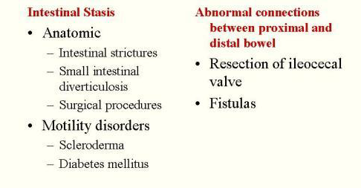
Conditions predisposing to SIBO

Slide 13
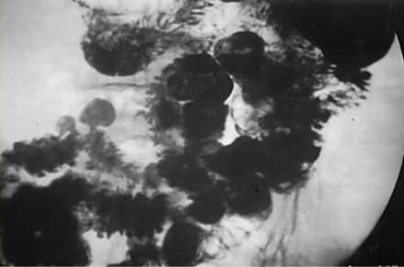
SI Diverticulosis

Slide 14
Pathophysiology of malabsorption in SIBO
Reduced nutrient availability
Bacteria consume nutrients
Bile salt inactivation
Excess bacteria de-conjugate bile salts
Unconjugated bile salts unable to solubilise micelles lead to fat malabsorption

Slide 15
Diagnosis of SIBO
Direct aspiration of jejunal contents
Breath tests
¹⁴C glycocholate – low sensitivity and specificity
¹⁴C xylose – not widely available
Lactulose or glucose
Measures expired H₂
Breakdown product of bacterial fermentation

Slide 16
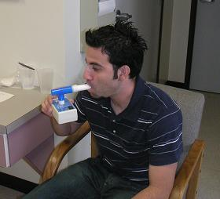
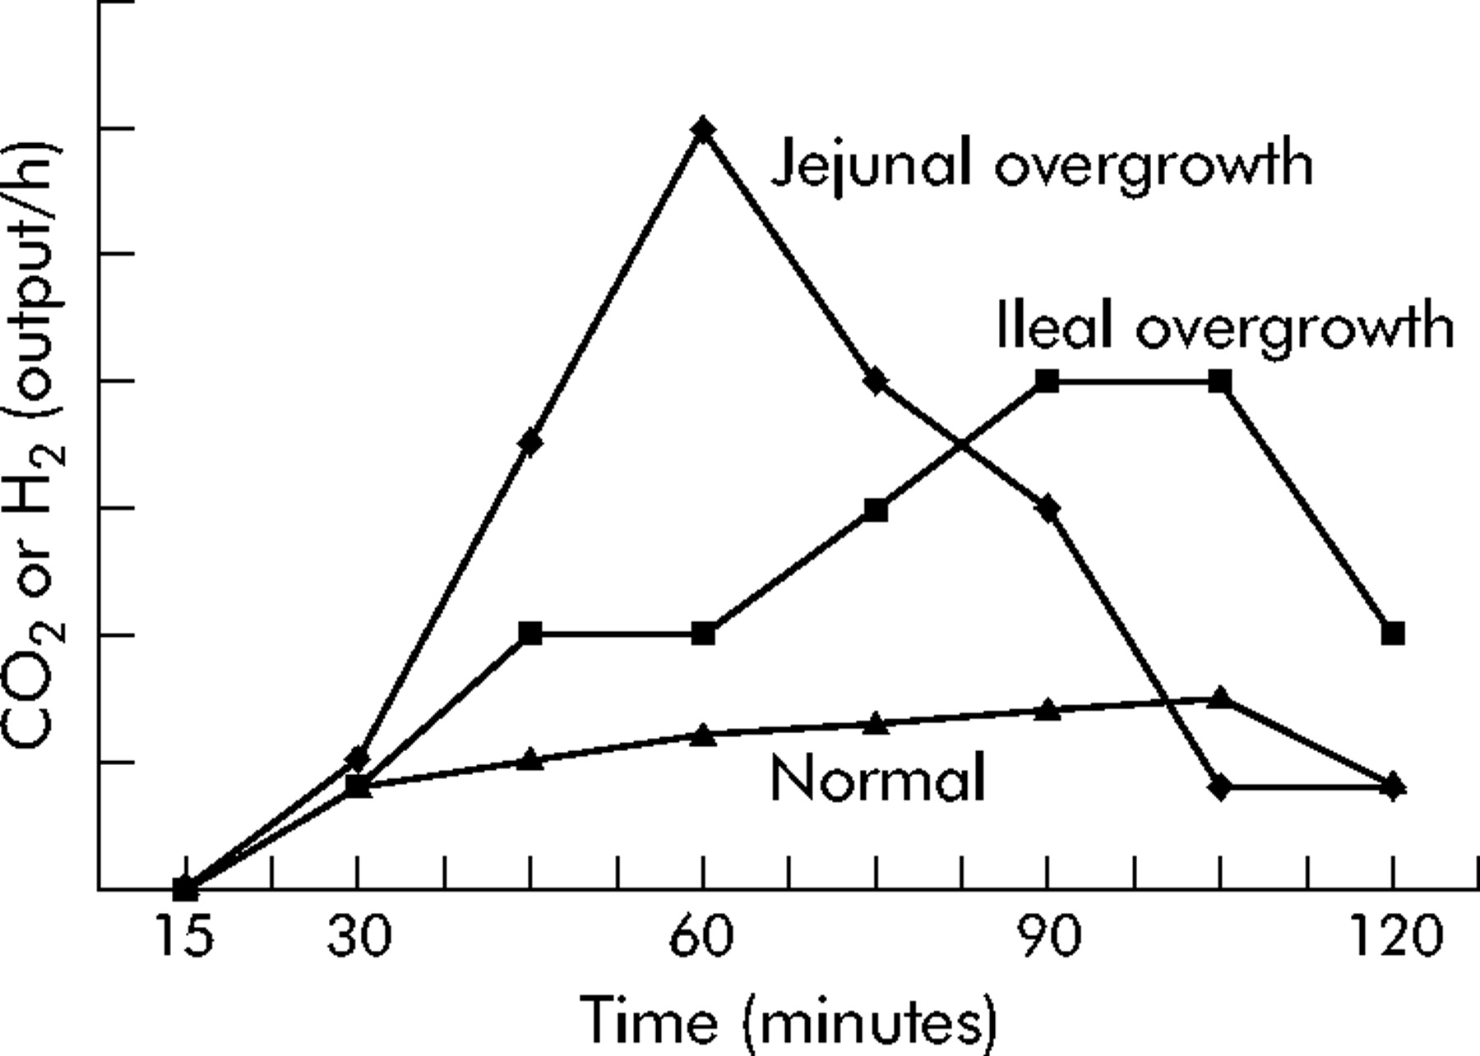
H₂ Breath test

Slide 17
Treatment of SIBO
Correct predisposing condition
Correct nutrient deficiencies
Rotational antibiotics

Slide 18
Increased bile salt losses
Mucosal disease in TI – Crohn disease or TB
Surgical resection or bypass of ileum
Mechanism of diarrhoea (cholerrheic or bile salt diarrhoea)
Fat malabsorption
Bile salts reaching colon cause secretion of water and electrolytes

Slide 19
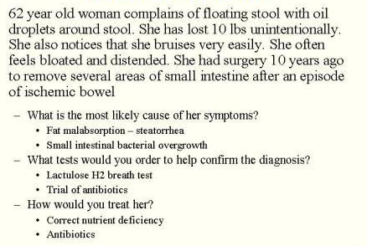
Case presentation 1 - answers

Slide 20
Defective nutrient hydrolysis
Lipase inactivation by excess HCl
(Zollinger-Ellison syndrome)
Pancreatic enzyme deficiency
Chronic pancreatitis
Pancreatic resection
Pancreatic cancer – obstruction of pancreatic ducts
Cystic fibrosis
Improper mixing or rapid transit of nutrients
Resection, bypass (gastro-jejunostomy) or rapid intestinal transit (hyperthyroidism)

Slide 21
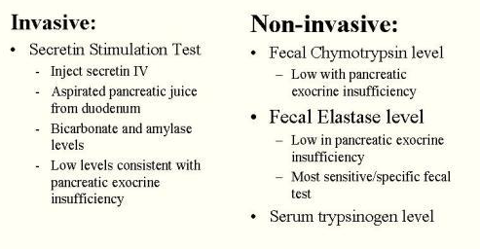
Tests for pancreatic insufficiency

Slide 23
Malabsoption : Mucosal loss
Extensive surgical resection
Short bowel syndrome
Extensive infarction

Slide 24
Malabsoption : Mucosal disease
Radiation enteritis
Complication of resection
Infection
Infestations
Vascular insufficiency (ischaemia)
Inflammatory
Crohn disease
Coeliac disease

Slide 25
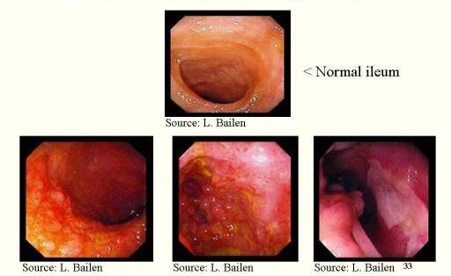
Mucosal disease: Crohn disease

Slide 26
Coeliac disease
Gluten sensitive enteropathy
Reaction against gluten in diet
Epidemiology: Whites (highest among Northern European descent)
Pathogenesis
Genetic
Environmental
Autoimmune

Slide 27
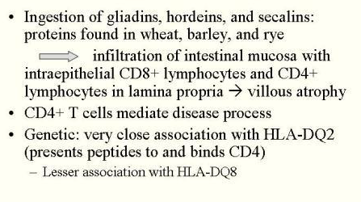
Coeliac disease: Pathogenesis

Slide 28
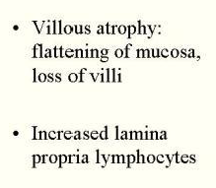
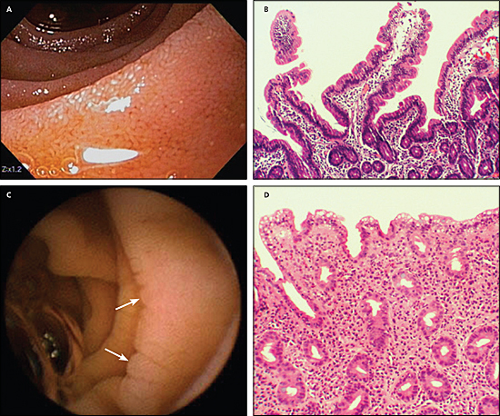
Coeliac disease: Pathology

Slide 29
Coeliac disease: Clinical presentation
Varied – depends on extent of mucosal disease
Typical – crampy abdominal pain, chronic diarrhoea, bloating, weight loss
Iron deficiency
Osteoporosis (vitamin D, Ca⁺⁺)
Easy bruising (vitamin K)
Peripheral neuropathy (vitamin B₁₂)

Slide 30
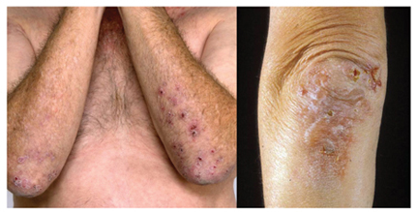
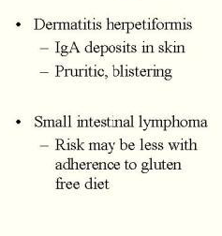
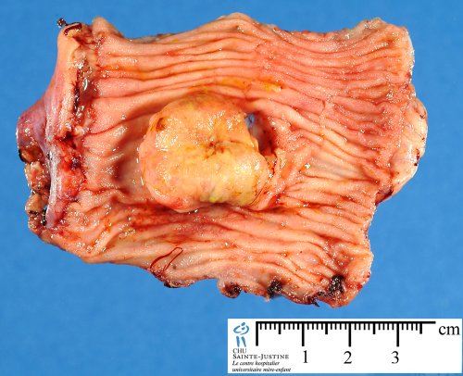
Coeliac disease: Associated disease

Slide 31
Coeliac disease: Diagnosis
Biopsy of small intestine on endoscopy
Blood tests
Tissue transglutaminase antibodies
Anti-gliadin antibodies
Anti-endomysial antibodies

Slide 32
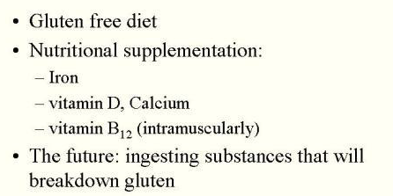
Coeliac disease: Treatment

Slide 33
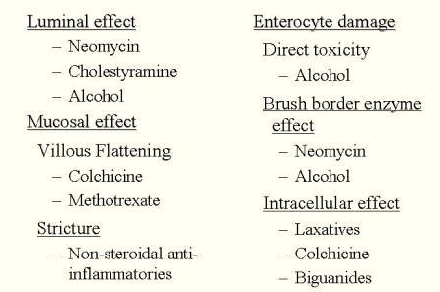
Drugs causing malabsoption

Slide 34
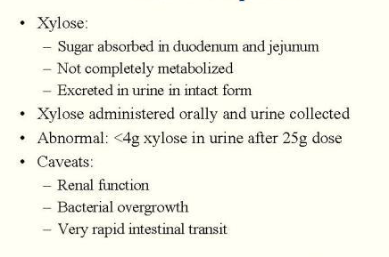
D- xylose test: General test for malabsoption

Slide 35
Selection of tests in evaluation malabsorption
Quantitaive faecal fat
Normal
Abnormal
D-xylose test
Normal
Abnormal
Abd. Radiograph
H₂ Breath test
Faecal elastase
CT abdomen
Normal
Small intestinal Bx
Abnormal
Jejunal culture
Antibiotics
Repeat breath test

Slide 36
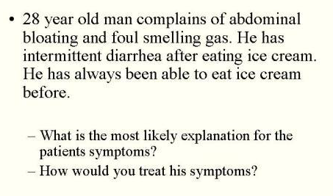
Case presentation 2

Slide 37
Osmotic diarrhoea
Excess amounts of poorly absorbed substances remain in intestinal lumen
Substances exert osmotic effect
Obligate water retention in intestinal lumen
Lactose, lactulose, Mg salts, PEG (poly ethylene glycol)

Slide 38
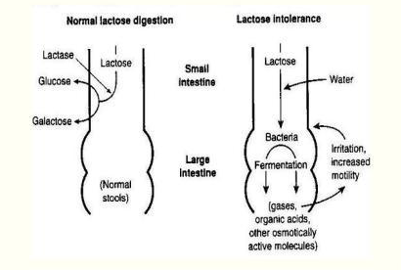
Lactose intolerance

Slide 39
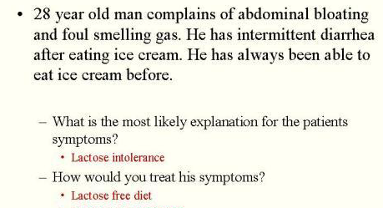
Case presentation 2 - answers

Slide 40
Medical Care
Management of malabsorption
Correction of nutritional deficiencies
Treatment of the causative disease

Slide 41
Nutritional support
Caloric and protein replacement
Supplementing minerals
Medium chain FAs (do not require miscelle formation)
Enteral
Parenteral

Slide 42
Treatment of causative disease
Gluten free diet - Coeliac disease
Lactose free diet – Lactose intolerance
Pancreatic enzyme supplements – Chronic pancreatitis
Antibiotics – Bacterial overgrowth
Corticosteroids, 5-ASA – for regional enteritis (Crohn diesase)

